Slide 1

Cloud Architecture
Presented by
Saikrishna Ganadi Shivam Pandey
Notes:
1-2Shivam
3sai
4shivam
5sai
6shivam

Slide 2
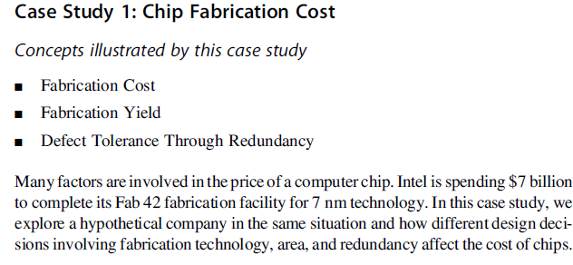
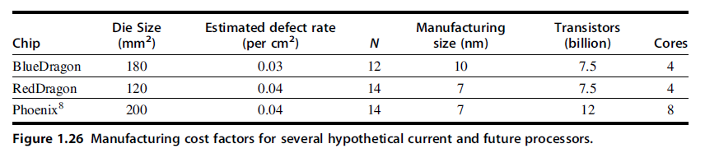

Slide 3
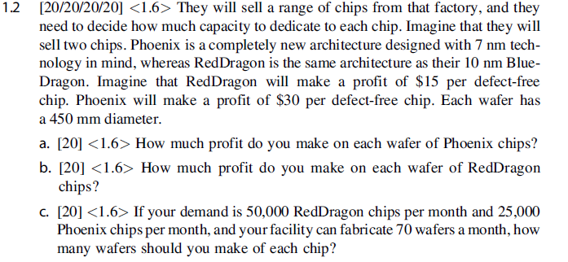

Slide 4

Q1.How much profit do you make on each wafer of Phoenix chips?
Soln:
= 3.14*(45/2)^2/2 - 3.14*45/square root of 2*0.5
= 724
= (1*1/(1+2*0.04))^14
= 0.34
Profit = wafer yield * yield * 30
= 724* 0.34*30
= $7384.8

Slide 5
Q2.How much profit do you make on each wafer of Red Dragon chips?
Soln:
=(3.14*((45/2)^2)/1.2) – (pi*45/(2*1.2)^0.5)
= 1234
= (1*1/(1+1.2*0.04))^14 = 0.52
=wafer yield * yield * 15
=1234x0.52x15
= $9625

Slide 6
Q3.If your demand is 50,000 Red Dragon chips per month and 25,000 Phoenix chips per month, and your facility can fabricate 70 wafers a month, how many wafers should you make of each chip?
Soln:
No of wafers of red dragon chips = 50000/1234 = 40
No of wafers of phoenix chips = 25000/724 = 34
Since the capacity to fabricate is 70 wafers a monthIy would make 40 wafers of red dragon chips and 30 of phoenix

Slide 7
Thank you

